Slide 1

INNOVATIVE SOLUTIONS
IN THE FACE OF CLIMATE CHANGE
Global Index Insurance Conference
September 14th, 2015
Paris, France
Notes:
To change the logo in the footer, go to the VIEW menu > Master > Slide Master, and replace the existing logo by your entity's logo.
To edit the confidentiality level, go to the INSERT menu > Header and footer, and fill in the desired level.

Slide 2
Climate change affects us all
  “Climate Change warrants AXA’s attention because both the science and the economics are crystal clear: we have no choice: a 2 ºC world might be insurable, a 4 ºC world certainly would not be.”
  Henri de Castries,
  Chairman and CEO of AXA Group
x5
x10
20%
Increase in the frequency of weather anomalies over the past 50 years¹
Cost for society²
The overall cost of risks associated with climate change represents between 5% and 20% of GDP³
¹World Health Organization, GIEC
²EM DAT Database
³Stern Report

Slide 3




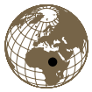

In this context, what role can insurers play?
  “As our business is about understanding risks and managing them for our clients, insurers are uniquely positioned to provide innovative solutions in partnership with public authorities but also relevant private players.”
  Henri de Castries,
  Chairman and CEO of AXA Group
KNOWLEDGE
PREVENTION
SOLUTIONS
426 granted projects so far
Parametric Insurance
ENHANCING OUR STRONG LOCAL PRESENCE

Slide 4
Going forward, AXA bets on big data to revolutionize the industry
MID-2000S
END 2000S
SINCE 2010
  First pilots with weather stations
  Data that allows for construction of indices but with a high basis risk
  Use of satellite imagery
  New data available through satellite imagery and allowing to compensate for lack of granularity
  Data science
  Big Data revolution helps us design the most appropriate insurance products

Slide 5
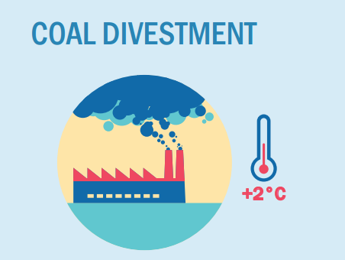
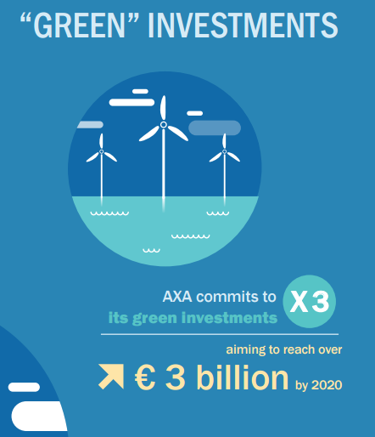
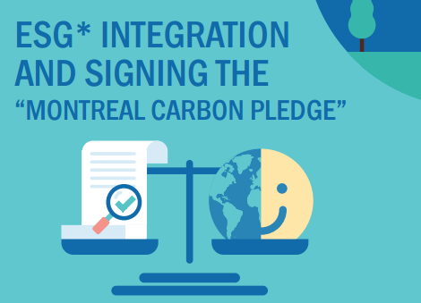
Over 2015, AXA has already taken 3 commitments
AXA has decided to divest from the companies most exposed to coal-related activities.
This initiative represents a divestment of
€ 0.5 billion
AXA has committed to measure the ESG* footprint of all relevant asset classes of its general account investments by the end of 2015.
*environmental, social, and governance

Slide 6
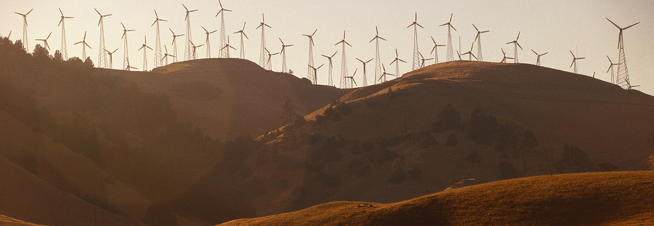





Climate change is a collective challenge
Donor partners

