Slide 1
Distribution
Distribution team is the first and in some cases, the only contact with the customer
It is not merely selling but an entire customer experience
premium collection
contacting
counselling
renewals
educating
enrolment
assisting in claims settlement
promoting

Slide 2
Channels- create value across the chain
Promotion
Enrolment
Premium collection
Education
Providing value-added services
Claims reporting
Claims assessment
Claims payment
What does it do now?
Could it do more?
What would the challenges be and the opportunities?

Slide 3
Possible channels
Financial institutions
Community-based
Informal retailers
MNOs
Village ‘chiefs’
Direct sales
Agent networks
Retail chains

Slide 4
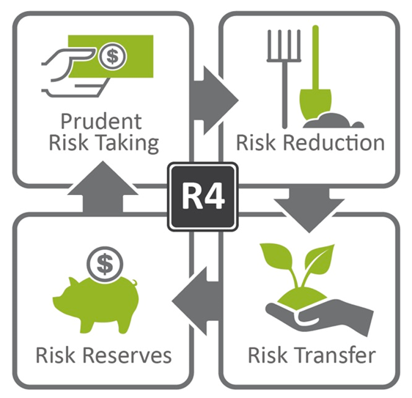
What is R4- how does it work
R4 Video
The 4 Rs
Notes:
Show R4 video, if not possible describe R4 in short using the next slide.

Slide 5
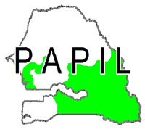
Partners/Delivery Channels
Partners and Channels
Notes:
This is just to show the number of partners we have in Ethiopia and Senegal.

Slide 6
Ethiopia- Flow Chart
Ethiopia Process Flow

Slide 7
Senegal Process Flow
IRI
CNAAS Senegal insurance company
Re-insurers
Chooses
Creates and maintains
Contribute in setting
INDEX DEVELOPMENT AND PAYOUT CALCULATION
INDEX
Contributes in setting
INSURANCE
PRODUCT & PRICING
Based on this:
CNAAS Senegal insurance company
Creates
INSURANCE POLICIES
WFP
Provides 50% premium (other half subsidized by Government)
FEBRUARY - MAY
Provides insurance policies to the SFC Associations
La Lumière
PAPIL & BAMTAARE
Provides participants lists to
REGISTRATION AND IFA PROCESS
Coordinates community engagement
SFC Associations
Manage IFA work
Registers and collects cash contributions from
FARMERS
Carry out
IFA
RAINY SEASON
JUN -SEP
IRI INDEX
Triggers
PAY-OUTS
PAYOUT DELIVERY AND INDEX REFINEMENT
Communicates outcome
AUG - DEC
SFC Associations
Oversees all payments
Calculate pay-outs and transfers funds
FARMERS
CNAAS & Re-insurers
Notes:
Role of delivery channels ranges from managing insurance for work activities (responsible for both quality and quantity of works), training, transfer of funds etc.

Slide 8
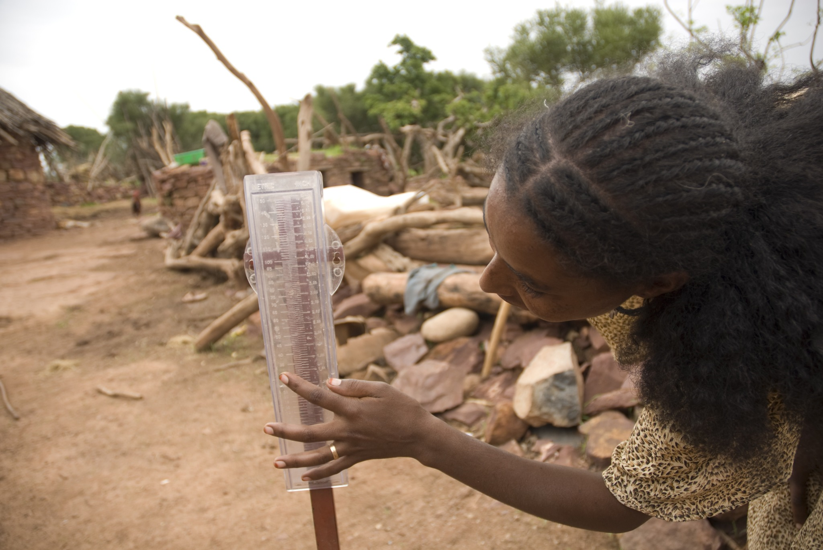

Slide 9
Subsidiaries
Green Delta Insurance Company
Client Centric organisation focused on customer satisfaction
Gross Premium Income BDT 2681.37 Million / USD 34.38 Million 2014
39 Branches: 19 online branches

Slide 10
Distribution Channels
GDIC
Future Partners Involvement with Farmers
Direct Involvement with Farmers
Partial Involvement with Farmers
Weather Forecasting Company
Mobile Network
Bank
MFI
NGO
Pesticide Company
Seed Company
Fertilizer Company
Farmers Co-operative
Farmer

Slide 11
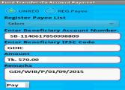
Link between all participants
Mobile Banking
Seed Company
Weather Data

Slide 12
Range of distribution partners
Advance Chemical Industries Pharmaceuticals Agriculture Inputs | IFC linkage for climate resilience Close links with farmers- farm inputs, credit facility and buy back arrangements Over 600 hectares and 500 farmers in Lalmonirhat & Kurigram directly involved
United Finance Limited Financial Investment Institution | Loan portfolio in remote & agri based areas Geographical spread - Noakhali, Bhola, Rangpur, Barisal, Rangamati Direct access with the farmers Well defined Operational Processes
SAJIDA Foundation NGO - Microinsurance Health Support Agriculture & Livestock Loans | Crop loans to small farmers Supports Agriculture and Livestock Unit improvement enhancing food security for vulnerable farmers Agriculture Investment in multiple locations Jamalpur & Chittagong

