Slide 1

PUTTING CLIENTS AT THE CENTER OF THE DESIGN AND SALES PROCESS
DETERMINING CLIENT VALUE
Global Index Insurance Conference
September 14th, 2015
Paris, France
Notes:
To change the logo in the footer, go to the VIEW menu > Master > Slide Master, and replace the existing logo by your entity's logo.
To edit the confidentiality level, go to the INSERT menu > Header and footer, and fill in the desired level.

Slide 2
Five key dimensions of client value in agricultural index insurance
Value for money
Client Value
Value adapted in
time and nature
Value through
technology
Value through
education
Value through
joining forces

Slide 3
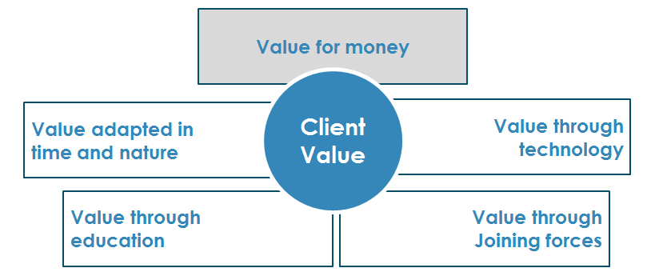
Value for money: index insurance is an appropriate models in developing countries
Frictional costs
5-10%
Public subsidies to foster farmers’ protection
Payback to the farmer
100%
Distribution costs
Claims handling costs
Support functions
Uncertainty loading
Higher distribution costs
Higher claims handling costs
Higher cost of support functions
5-10%
Lower distribution costs
No claims handling costs
No adverse selection
No moral hazard
25 –
35%
50 –
70%
Traditional insurance
Traditional insurance in developing countries
Index
Insurance combined with a meso-approach/light broker
Index Insurance with subsidies

Slide 4
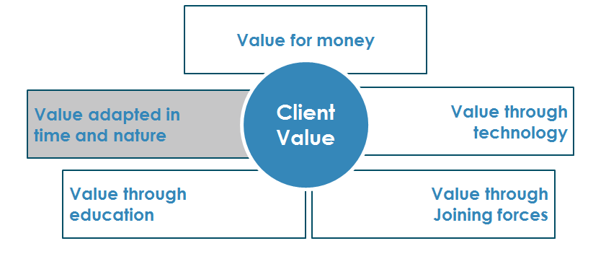
Value adapted in time and nature: index insurance can contribute to breaking the poverty trap cycle
Adapted in Time
Adapted in Nature
Index insurance provides one of
the most rapid payouts
Index insurance can contribute to breaking the poverty trap cycle
Cost in $ by household in East Africa
Increased sensitivity to adverse weather conditions
Inability to buy new entrants
Poor yield/crop destruction
Poverty
trap
No access to credit
Selling of assets
Step at which insurance can break the cycle
Time in Months
* From a study in East Africa conducted by the World Bank Group
Notes:
One study in East Africa found that the cost of a drought to households increases from $0 to $50 per household if support is delayed by four months after harvest and to $1,300 if support is delayed by six months or more due to the impact on children and distress sales of livestock and other property.¹ (from the world bank group)

Slide 5
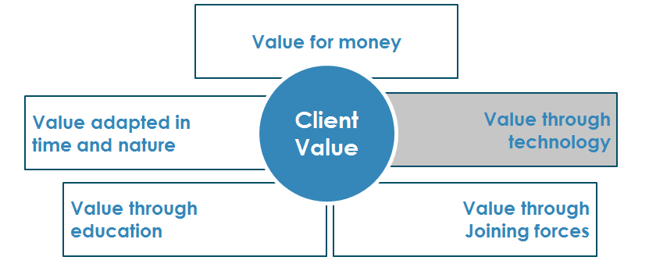

Value through education: information campaigns are key
Levels of comprehension complexity
Reinsurer/ global insurer
Development of models, technical expertise, and “geomatics”
Local insurer
Full understanding of model’s output and relevance to local market
Aggregator/Broker
Understanding of aggregated risk and capacity properly inform farmers
Farmer
Clear understanding of event covered, frequency, cost and pay-out
The GIIF can intervene at every level
Notes:
Index insurance is new in most markets and still not fully understood
Need for mathematical comprehension and financial literacy
Need to build trust in the product and the local banks/insurers
All stakeholders must be at ease . We train the trainer and partner with a third part to ensure that there is a good enough understanding of the product.

Slide 6
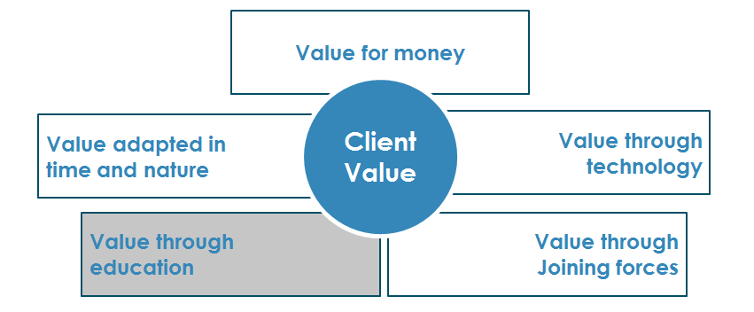
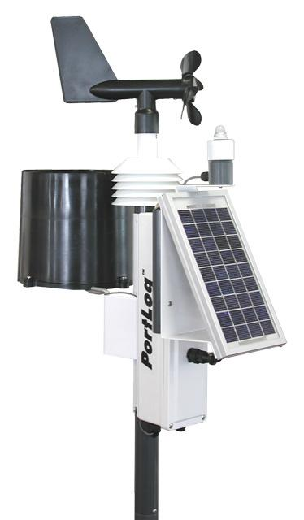
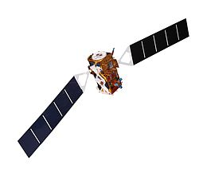

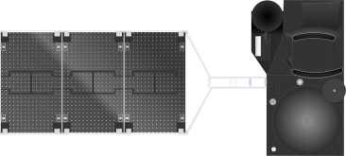
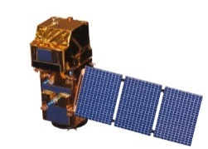
Value through technological progress: improvements in technology are revolutionizing the industry
MID-2000S
END 2000S
SINCE 2010S
  First pilots with weather stations
  Data that allows for construction of indices but with a high basis risk
  Use of satellite imagery
  New data available through satellite imagery and allowing to compensate for lack of granularity
  Data science
  Big Data revolution helps us design the most appropriate insurance products
Notes:
Improvements in technology lead to more affordable premiums because the insurance company is able to quantify more accurately the probabilities of payout and is covering less risk
More benefits as there is more data worldwide
Use of data science to combine consulting and insurance

Slide 7
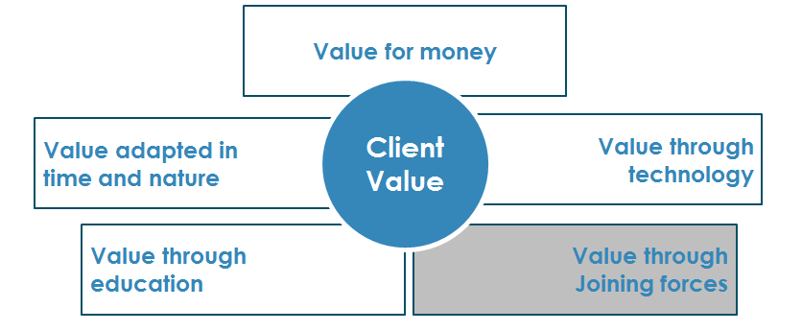
Value through joining forces: to tackle the food security problem, we all have a role to play
Brokers
Aggregators (e.g. banks, cooperatives)
Distributors
Private Sector
Meteorologists
Governments
Farmers
Academics
Financial Institutions
International Organizations
Data Scientists
Reinsurers/ Insurers
Farmer’s associations
Media
Joining forces: everyone has a role to play

Slide 8
  Thank you

