Slide 1




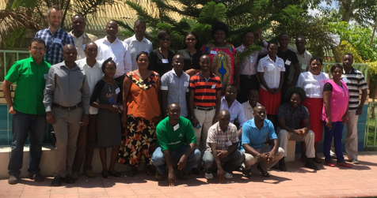
Index insurance consumer education in Zambia
Project design and initial results
December 2, 2016

Slide 2
Outline
Background on products and distribution, and current understanding among farmers
Our consumer education approach
Initial results after training of agents
Next steps

Slide 3
  1. Background

Slide 4
Products and outreach in 2015/16 season
Insurer | Aggregator | No of farmers | Sum insured (ZK) | Product details
Mayfair | ZNFU | 3,491 | 18,796,130 | 5k+ ZK sum insured per policy, linked to Lima credit scheme for maize production (20k farmers in total); two seasons; mandatory
 | ILO Yapasa (Winds of change, Manyika, Victor) | 660 | 1,848,000 | 2.8k ZK sum insured, soya only for youth with a training package; one season
 | GoZ FISP e-voucher | 1,546 | 2,164,400 | 1.4k ZK sum insured, amount of input package within FISP (50% subsidy by govt matched with farmer’s contribution; includes fertilizer), mostly maize but can be used for diversification; one season on a pilot basis; not embedded, enrolment done separately, premiums subsidized by Musika (50%) for the pilot. For next season the value of the pack will be 2.1k ZK with just 400 ZK paid by farmer.
 | NWK (medium-scale) | 80 | 23,650,000 | For mechanized farmers; brokered by AON; one season
 | WFP | 500 |  | Embedded within broader resilience initiative R4; in-kind contribution to FAO’s climate-smart ag program in exchange of insurance coverage. IRI-developed index using a hybrid between weather stations and satellites.
Focus | NWK (small-scale) | 51,827 | 15,924,100 | Mostly cotton, some soya; sum insured just 300 ZK for 30 ZK premium including life cover (5 ZK for 1000 ZK cover), three seasons; mandatory at shed level
 | ZNFU | 1,196 | 6,871,468 | Same as the 1st product above
All products but WFP use satellite imagery, were designed and are administered with support from Risk Shield consultants
While design varies in terms of locations and sums insured, it is possible to distil a generic product to be ‘taught’ to farmers
Product is complex as it pays on a proportional basis and depending on the period
Some basis risk was observed; the policy document allows some extent of loss verification and payout adjustment if it is reported by farmers/aggregators
Many payouts last season (total claims amount approx. USD 550,000); most not paid out immediately due to data issues
Notes:
25k farmers under FISP in Choma (with 700k enrolled nationally – check number); criteria: be a farmer, belong to a farmer group (100 kw per year fee), be in the right locality; a bit more than 50% can get to it; some rationing because of the budget. It is supposed to be targeting the poorest through community check but this seems not be happening. 48 dealers affiliated in Choma.
Main objective of the FISP program is to diversify; perception that subsidy should go to maize production though, but insurance should be perceived as a cushion for any weather risks as the product is generic, and weather affects most of the ag production anyway; so for whatever farmer uses e-voucher it will give him / her a cushion anyway; no need to make it specific to crops in this case – used as a foundation weather product.
NWK model is the most efficient and leverages the aggregator incentives to do the job. NWK has 68k farmers; so almost all are covered. There are 6-8 other cotton buyers like this aggregating 350k farmers. Alliance has 45k farmers. They all very similar with a difference for Cargill as they add fertilizer to input pack. Insurance used to cover risk but also differentiate. Side-selling has been curbed by the industry but still farmers can switch output buyers before the season; and insurance can make a trick if it’s better understood.

Slide 5
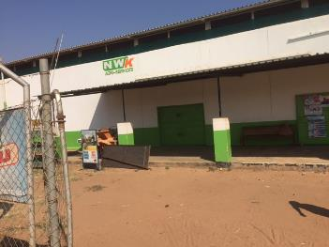
Current process (NWK)
NWK’s shed managers are trained by RS (8-10 sheds by zone)
Shed managers train their ‘distributors’ (lead farmers; ~20 per shed)
‘Distributors’ with help from shed managers promote the product during pre-planting ~1-hour meetings (few big per shed and many small)
Payouts (if any) combined with end season payments
Shed managers and distributors enrol farmers; inputs distributed
Cotton production trainings; farmers visit NWK shop for more inputs etc
Agriculture fairs during Jul-Sep
NWK runs contract farming (mostly cotton), provides input package on credit that includes insurance; premium and loan repayment deducted when crop delivered.
NWK own staff on the field include are manager and shed managers. Crop is delivered to sheds. Each shed manager has a number of ‘distributors’ who are farmers who promote and enrol other farmers in their area to the contract farming scheme. They are paid on commission depending on w much crop they collect (on average it’s 4k ZK per season).
Insurance distribution (aside) is done in a relatively consistent way for three seasons by NWK staff supported by Risk Shield with min inputs from Focus
Notes:
NWK would not actually want to tell farmers about payouts during the season. This is because NWK fears this can send out a wrong signal to the farmers that they do not need to deliver the crop as the insurance will pay! This is the main reason why NWK has actually stopped us in earlier seasons (including the last one) from communicating payouts to the farmers. They prefer to keep quiet about payouts until farmers deliver and then pass on payouts only at point of delivery of crop. This has to be kept in mind during planning of the communication strategy during the season.

Slide 6

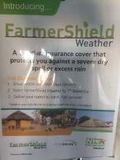
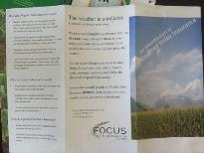

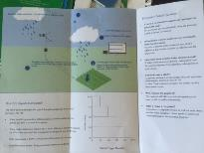

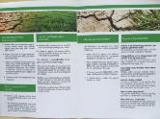
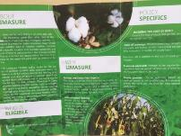

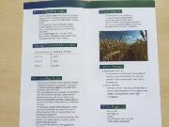
Current consumer education effort
Not much beyond a standard sales process
No visuals but text-heavy leaflets with some FAQs, translated into local languages (see pictures aside)
Ad-hoc explanations to groups, individuals, aggregators
No use of mass media channel besides some use of radio for NWK marketing
Other relevant info to design consumer education:
  ‘agents’ working for distributors have low insurance literacy
  ‘agents’ do not have tablets, some have smart phones; farmers have basic phones
  Education needs to be in local language
  IAZ runs some activities at national level, which boils down to insurance week, which is happening every October (workshop at schools, some radio spots and roadshows but not targeting farmers); around 3k USD to develop a 5-minute radio spot; 20-50 USD for airing time with local radio stations
  Local radio stations are popular among farmers
  WBG supports creation of the national financial inclusion strategy that should include some educational elements (draft not available)

Slide 7
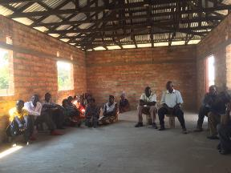
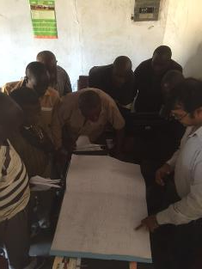
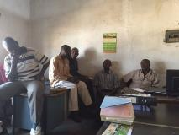
Farmers’ understanding
General understanding how weather-based insurance works seems to be universal for more mature schemes
However, farmers have no knowledge about key elements of the product; key issues:
  no clarity how pay-outs are calculated (‘we got 115 kwacha but we don’t know why; they told us minimum was 200 kwacha’) and how claims will be paid
  no understanding how rainfall is verified, especially that there is rarely a physical visit, often brought to attention if there is basis risk
  some confuse index with indemnity (especially better off farmers who used ‘traditional’ indemnity products); and also confuse inputs insurance with yield insurance
  no clear communication / complaints channel
‘Agents’ understand some basic product features, but a full understanding is not there even for NWK scheme that is in place for three years so they cannot transfer information

Slide 8
  2. Our consumer education approach

Slide 9
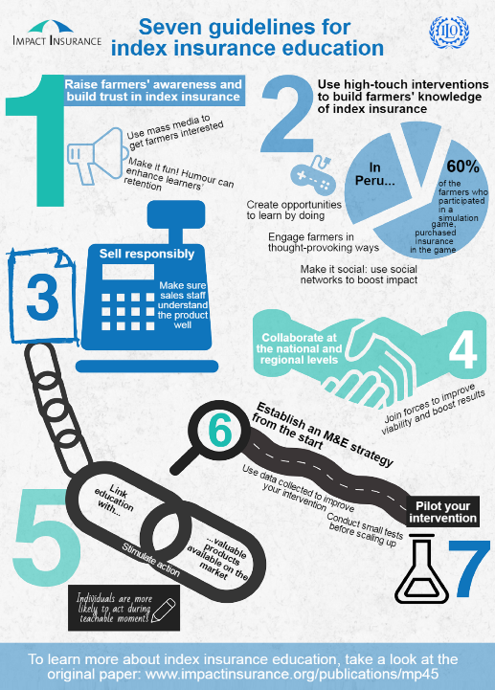

Consumer education for index insurance
Given limited resources and tight deadlines before the new season we are starting with a set of simple interventions to build capacity of ‘agents’ to sell insurance responsibly with the aim to improve understanding of products among current clients.
If successful we can then use radio and agriculture fairs to further raise awareness and build knowledge of other potential farmers before the 2017/18 season.

Slide 10
Responsible selling and index insurance education within distribution: Process flowchart
Consumer education needs to be embedded in the current distribution process
It needs to be ongoing, i.e. leverage at least 2-3 touch points and not to be limited just to pre-season promotion session
Using NWK as an example we present a model flowchart for education activity. It can be adapted to other distribution models such as FISP, ZNFU, WFP etc.
For each step in the process, ‘agents’ are equipped with guides and visual aids to effectively transfer information. The entire process is monitored by RS/supervisors (e.g. shed managers) using a simple protocol. Supervisors will strive to run follow-up peer learning sessions for their agents to facilitate their understanding.
We will monitor the cost-benefit of this type of intervention.
If benefits (renewals!) outweigh costs, providers should pay for it themselves. It should probably be continued in an intensive manner during several seasons. As soon as the agriculture insurance culture is established, the process can be simplified.
NWK’s shed managers are trained by RS (8-10 sheds by zone)
Shed managers train their ‘distributors’ (lead farmers; ~20 per shed)
‘Distributors’ with help from shed managers promote the product during pre-planting ~1-hour meetings (few big per shed and many small)
Payouts (if any) combined with end season payments
Shed managers and distributors enrol farmers; inputs distributed
Cotton production trainings; farmers visit NWK shop for more inputs etc
Agriculture fairs during Jul-Sep
6. In-between seasons education activities (part II of the solution)
1. Master ToT by RS
2. ‘Agent’ ToTs by shed managers
5. ‘Agent’ explains payout amounts or no-payouts
3. ‘Agent’ sells responsibly and explains the product
4. ‘Agent’ runs pay-out simulation meetings with data so far mid-season (Feb)

Slide 11
Roles and tools
 | Risk Shield / ILO | Agents | Lead farmers
Training of agents | Conduct ToT manual | Participate
Training for lead farmers | Support | Conduct Guide, posters | Participate
Training for farmers |  | Support | Conduct Guide, posters, leaflet
Monitoring | Support | Conduct Monitoring form | Conduct Monitoring form
Follow up meetings | Support | Conduct Guide | Participate
Evaluation | Analyze | Conduct Survey | Participate

Slide 12
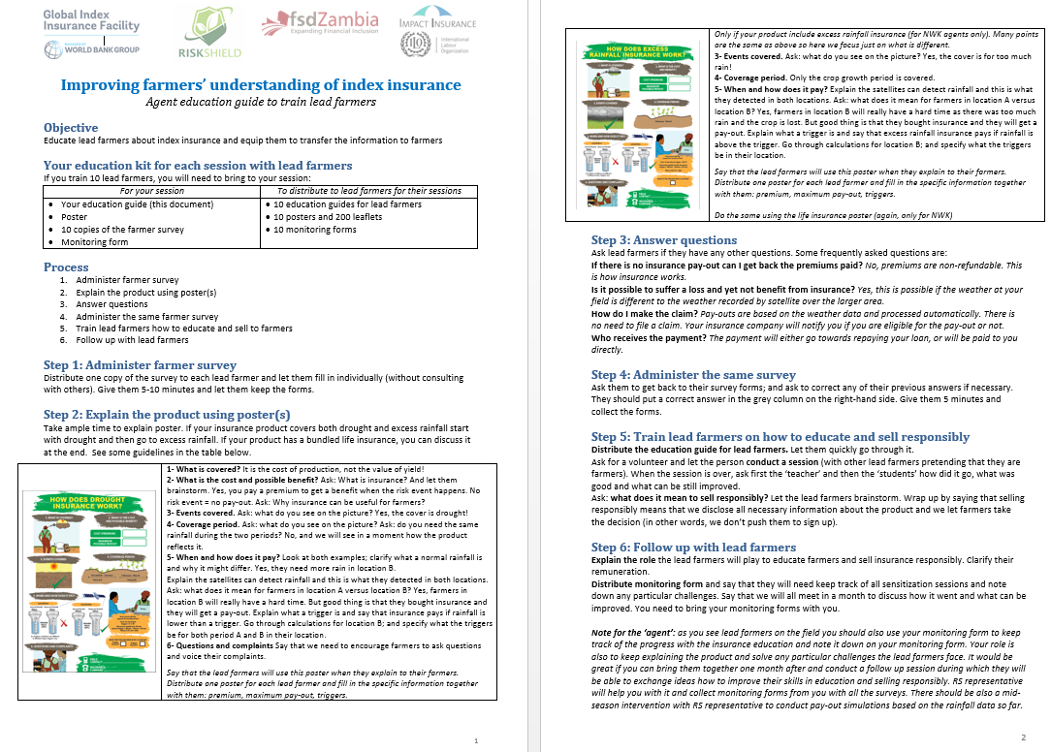

Slide 13
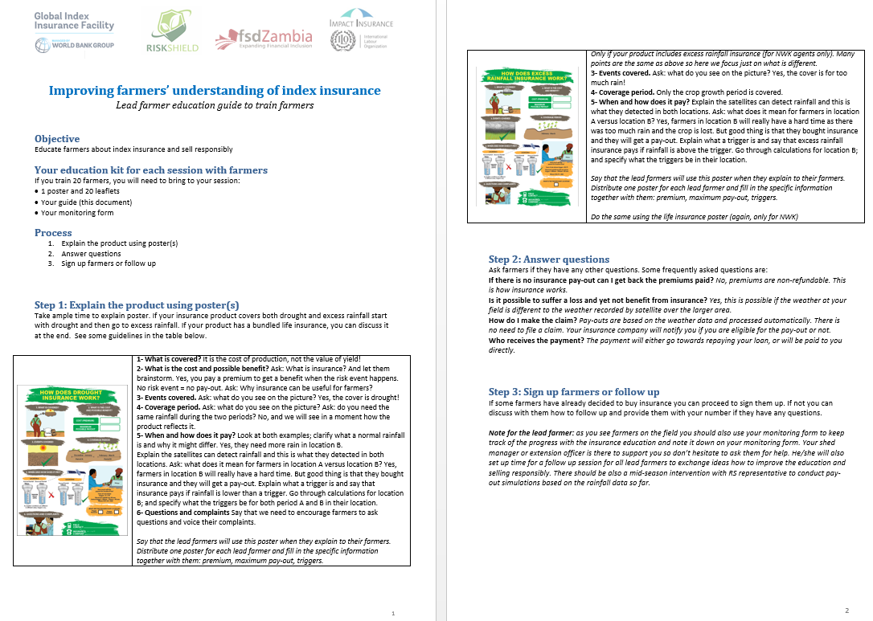

Slide 14
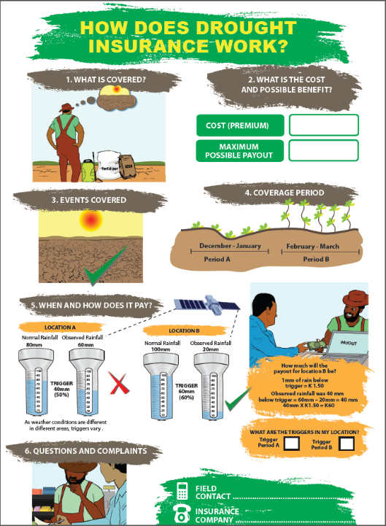
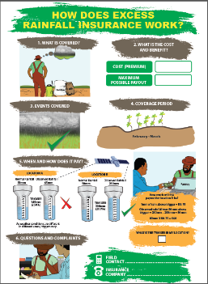


Slide 15
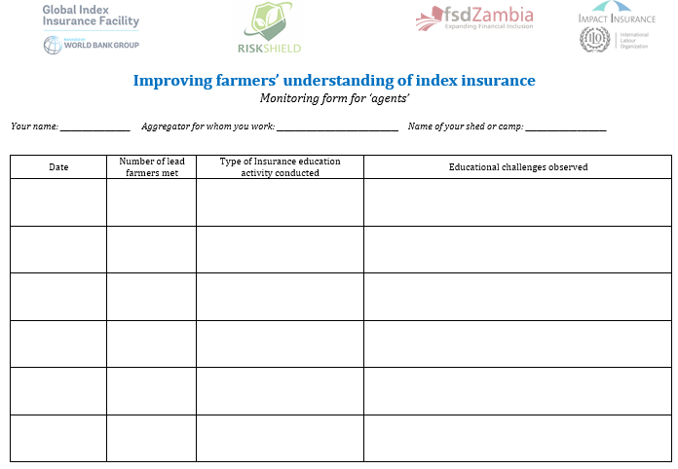
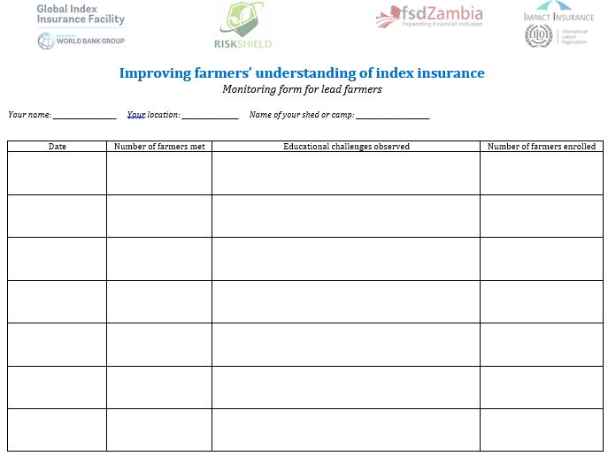

Slide 16
  3. Initial results

Slide 17
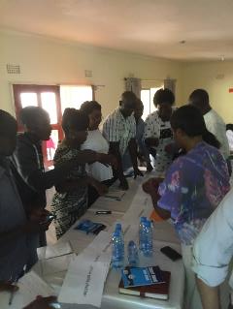
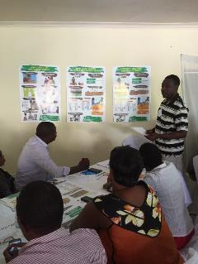
Training of agents
Delivered by ILO and RS on 23-24 November using adult learning methodology powered by the ToT package (trainer’s guide, slides, handouts)
21 agents from 3 aggregators (NWK, FISP-MoA, Jedo-ILO Yapasa) participated long with reps from ILO, FSDZ
High satisfaction among participants (on scale 1-5; 4.63 on content/materials, 4.21 on logistics)
‘This is the Christmas bonus to our farmers!’; ‘Well elaborated, simplified and easy to be adopted’; ‘I understand the role of index insurance and its operations and I will be able to roll it out to lead farmers’
 | Time | Session
Day 1 | 9:00-9:45 | Welcome and introductions
 | 9:45-11:00 | Understanding risks and how to deal with them effectively
 |  | Tea break
 | 11:15-12:15 | Introduction to index insurance
 | 12:15-13:15 | Overview of the consumer education intervention
 |  | Lunch break
 | 14:00-15:15 | Understanding your index insurance product
 |  | Tea break
 | 15:30-17:15 | Understanding your index insurance product
Day 2 | 8:00-10:30 | Understanding your index insurance product
 |  | Tea break
 | 10:45-13:15 | The way forward: Your contribution to insurance education (1)
 |  | Lunch break
 | 14:00-15:30 | The way forward: Your contribution to insurance education (2)
 |  | Tea break

Slide 18
Substantial knowledge improvements among participating agents
Based on the same survey administered before and after ToT; n=24

Slide 19
Understanding how to calculate pay-outs is still a challenge…but should get improved with follow-up sessions
Calculation spreadsheet
Shed in Kabwe, Central Province
 | normal rainfall levels (mm) |  | observed rainfall (mm) |  | % of normal rainfall
 | 10 day periods | 20 day periods | 10 day periods | 20 day periods | 10 day periods | 20 day periods
20th Dec | 52 |  | 51
31st Dec | 53 | 105 | 25 | 76 |  | 72%
10th Jan | 19 | 72 | 15 | 40 |  | 56%
20th Jan | 98 | 117 | 24 | 39 |  | 33%
31st Jan | 59 | 157 | 62 | 86 |  | 55%
10th Feb | 61 | 120 | 130 | 192 | 213% | 160%
20th Feb | 55 | 116 | 47 | 177 | 85% | 153%
28th Feb | 52 | 107 | 5 | 52 | 10% | 49%
10th Mar | 51 | 103 | 17 | 22 | 33% | 21%
20th Mar | 59 | 110 | 13 | 30 | 22% | 27%
31st Mar | 44 | 103 | 62 | 75 | 141% | 73%
# row |  | Cover | Value | Notes
1 | ACTUAL INDEX VALUES | Early Dry Spell | 33% | Min % in period A
2 |  | Late Dry Spell | 21% | Min % in period B
3 |  | Excess Rainfall | 213% | Max % in period B
4 | TRIGGER LEVELS | Early Dry Spell | 50% | From policy spreadsheet
5 |  | Late Dry Spell | 40%
6 |  | Excess Rainfall | 250%
7 | VARIATION FROM TRIGGER | Early Dry Spell | 17% | row (4) - row (1)
8 |  | Late Dry Spell | 19% | row (5) - row (2)
9 |  | Excess Rainfall | 37% | row (3) - row (6)
10 | MIN PAYOUT | Early Dry Spell | 0% | From policy document
11 |  | Late Dry Spell | 0%
12 |  | Excess Rainfall | 0%
13 | MAX PAYOUT | Early Dry Spell | 30%
14 |  | Late Dry Spell | 40%
15 |  | Excess Rainfall | 30%
16 | RATE OF PAYOUT | Early Dry Spell | 30%/50%=0.6 | [row (13) – row (10)]/ row (4)
17 |  | Late Dry Spell | 40%/40%=1 | [row (14) – row (11)]/ row (5)
18 |  | Excess Rainfall | 0.25 | [row (15) – row (12)]/ row (6)
19 | ACTUAL PAYOUT (% OF SUM INSURED) | Early Dry Spell | 17%x0.6=10.2% | row (7) x row (16)
20 |  | Late Dry Spell | 19%x1=19% | row (8) x row (17)
21 |  | Excess Rainfall | 0% | 0.25 (fixed rate)
22 | GROSS PAYOUT | Gross Pay-out | 29.2% | Sum of rows (19, 20, 21)
23 |  | Deductible | 0% | From policy document
24 | NET PAYOUT | Net Payout | 29.2% | row (22) – row (23)
25 |  | Sum Insured (ZWK) | 300 | From policy document
26 |  | Number of packs | 2 | From policy document
27 |  | Payout (ZWK) | 600x29.2%=180 | row (24) x row (25) x row (26)
28 |  | Raw-Payout/ pack (ZWK) | 90 | row (27) / row (26)
TRIGGER LEVELS (% OF NORMAL RAINFALL LEVELS) | Early Dry Spell | 50%
 | Late Dry Spell | 40%
 | Excess Rainfall | 250%

Slide 20
  4. Next steps

Slide 21
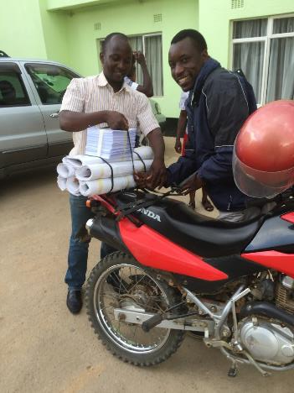
Next steps
Agents conduct sessions for lead farmers supported/monitored by RS (Dec)
Lead farmers conduct sessions and enrol farmers supported/monitored by agents (Dec)
Mid-term evaluation and mid-seasons follow up sessions with agents / lead farmers (Feb)
Final evaluation, farmer knowledge surveys, cost-benefit analysis (Apr)
Toolkit packaging and preparing roll-out for next seasons (May-July)
(funding permitting) Additional mass-media interventions (Jul-Sep)

Slide 22









Contact us: fonsecac@ilo.org
With generous support from:

